Slide 1
Predicting Vegetarian User Purchase Behavior
Musa Irshad

Slide 2
Business Problem
Stakeholder is Instacart and stores
Understand vegetarian user purchase patterns from Instacart
Offer users incentives and recommendations
How can we predict users first time order or re-order with highest accuracy?
What is distribution of days between users prior order and then re-order?

Slide 3
Data Understanding
Data Source :https://www.kaggle.com/datasets/psparks/instacart-market-basket-analysis
Publicly available on Kaggle
Contains over 5 million instances of orders made via Instacart grocery shopping app
Indicates the frequency of order placements
Specifies whether orders were reordered or not

Slide 4
Data Exploration and Cleaning
Merged four datasets (products, aisles, orders, departments)
Filtered data for food-related orders
Handled missing values in "days_since_prior_order“
Dropped the missing values
Slightly imbalanced data (More re-orders than first-time orders)

Slide 5
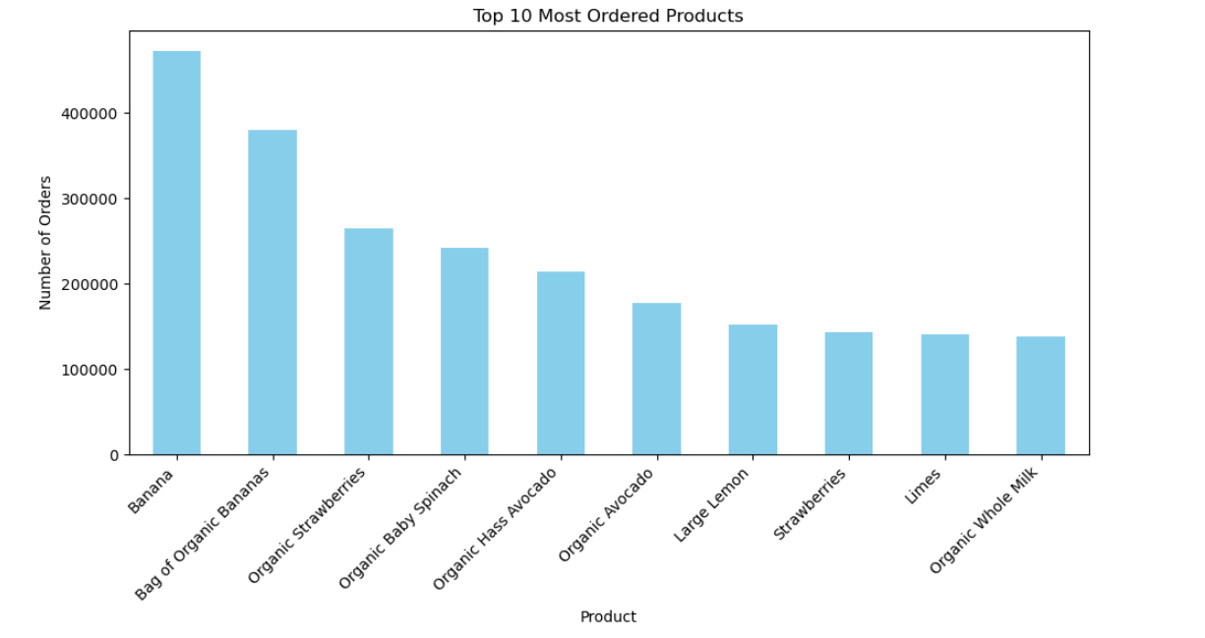
Exploratory Data Analysis
Top 10 Most Ordered Products

Slide 6
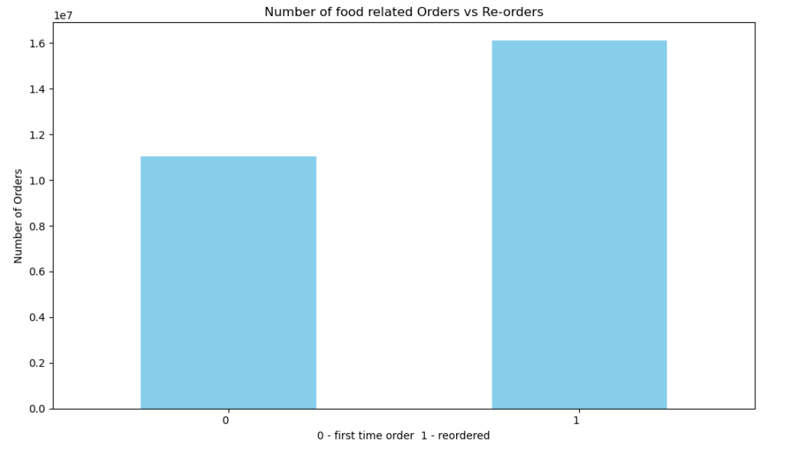
Exploratory Data Analysis (contd.)
First Time Order vs. Re-order of Products

Slide 7
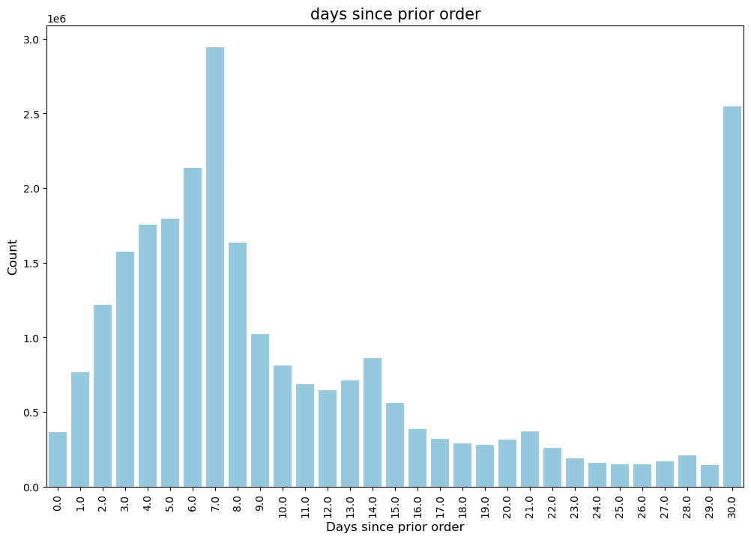
Exploratory Data Analysis (contd.)
Distribution of Days Since Prior Order
Most frequent between 4-8 days

Slide 8
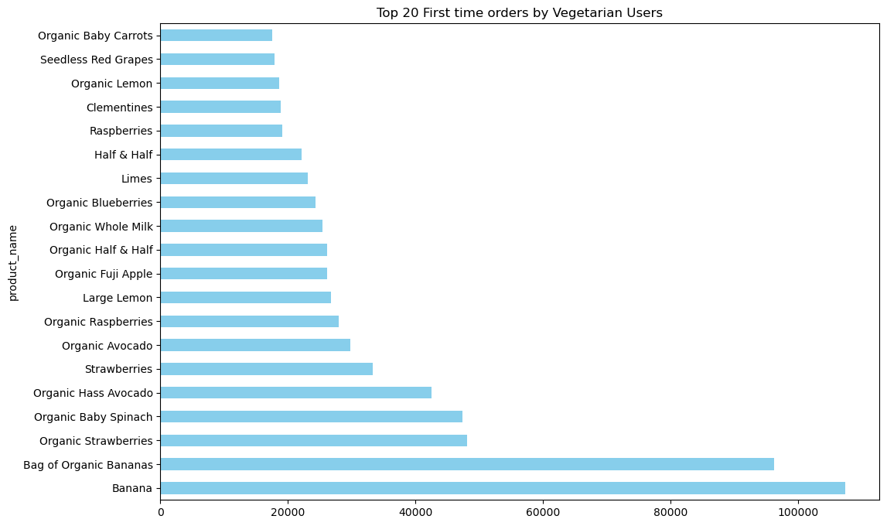
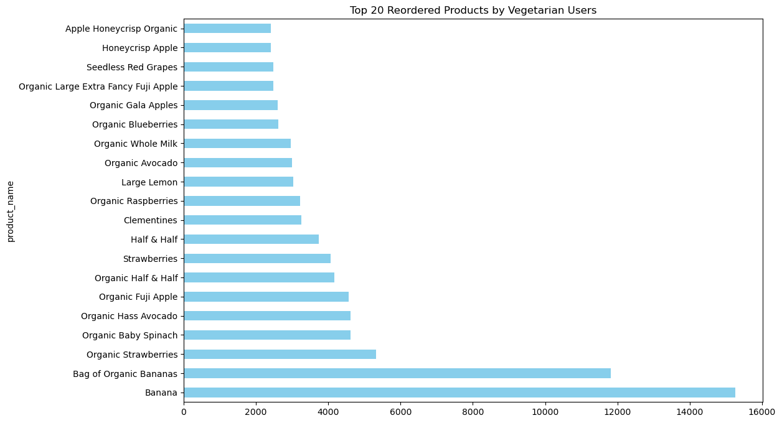
Vegetarian User Analysis
Top 20 Products Ordered by Vegetarian Users
Top 20 Products Re-ordered Weekly by Vegetarian Users

Slide 9
Model Development
Target Feature: “Reordered”
Dropped non-numeric columns for model training
Split the data into 70% training and 30% testing
Trained and evaluated 7 ML Models:
Logistic Regression
Decision Tree Classifier
XGBoost, Random Forest
Naïve Bayes Classifier
Voting Classifier
Stacking Classifier

Slide 10
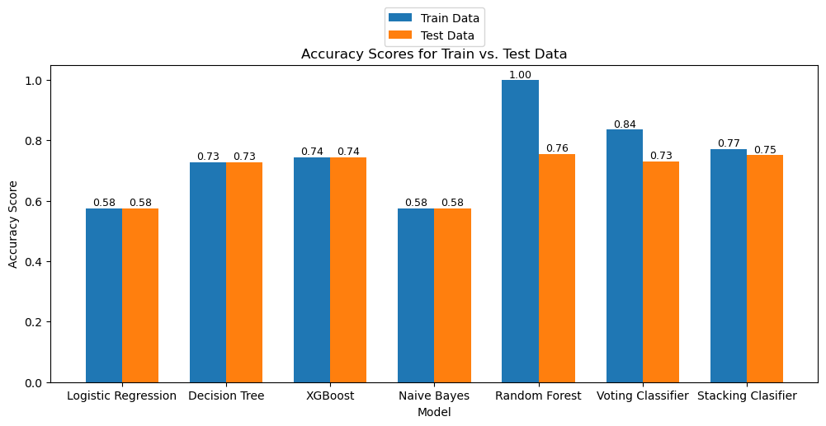
Model Results

Slide 11
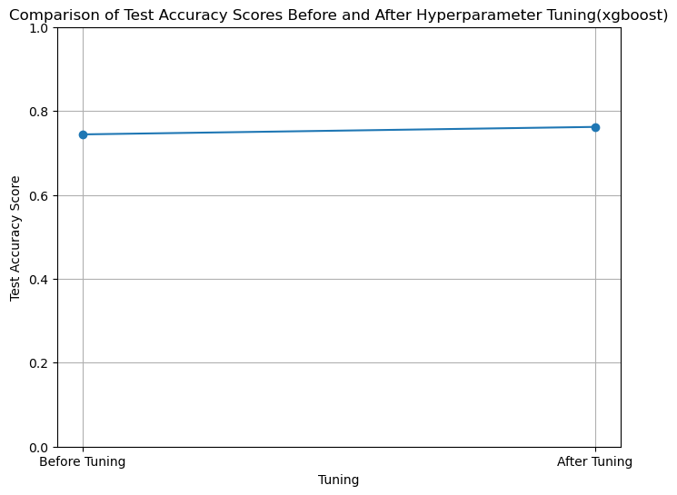
Hyperparameter Tuning
XGBoost improved test accuracy (74% to 76%)

Slide 12
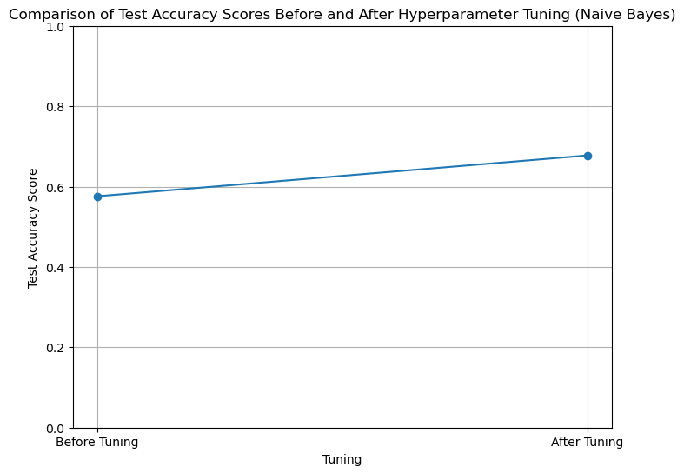
Hyperparameter Tuning(contd.)
Naïve Bayes improved test accuracy (58% to 68%)

Slide 13
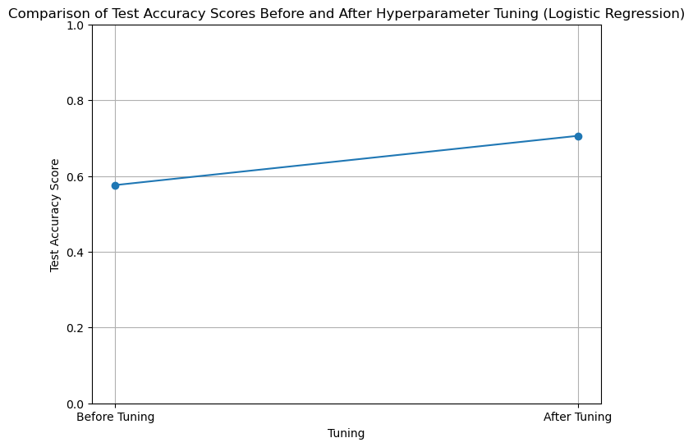
Hyperparameter Tuning(contd.)
Logistic regression improved test accuracy (58% to 70%)

Slide 14
Conclusion
Aimed to classify vegetarian users' first-time orders versus re-orders using different ML techniques.
Tuned XGBoost, resulting in an accuracy improvement from 74% to 76%, Naïve Bayes 63% to 66% and logistic regression 58% to 70%.
Most users reorder within 4-8 days of their first order
The analysis offers insights for understanding user behavior in online food ordering platforms, paving the way for predictive modeling to enhance customer experience and operational efficiency.

Slide 15
Next steps
Will make smaller subsets of dataset and turn non-numerical columns to numerical columns to make better predictions
Obtain more data to make recommendations for vegetarian users including nutritional information

Slide 16
Thank you, Any Questions?
Musa Irshad
www.linkedin.com/in/musairshad
https://github.com/musairshad

